Slide 1
SentinelFleet

Slide 2
Team: 040.ExE
Sheryll Jacquet – Software Engineering Major, Senior
Johanna Devilme – Software Engineering Major, Sophomore
Hector Meza - Software Engineering Major, Junior
Tajae Bromfield - Software Engineering Major, Junior

Slide 3

Overview of Product
Sentinel Fleet is a program designed to enhance Hertz's response to natural disasters by ensuring vehicle availability in affected regions.
Our solution establishes main hubs located outside disaster-prone areas, where a large fleet of vehicles is stored. Once the disaster has passed, these hubs deploy cars to impacted regions, ensuring Hertz maintains a consistent supply.
The program facilitates vehicle transfers by allowing main hubs to request cars from regions unaffected by the disaster that have an excess supply.

Slide 4
Problem To Fix with our solution
Bankruptcy (Limited inventory, Sale overturn)
Natural Disasters (unavailable stock, loss in sales, loss of stock in from stores stationed in impact areas)
Economy Fluctuation and Trends
Competition

Slide 5
Product benefits
Assurance will reach them to greater heights

Slide 6
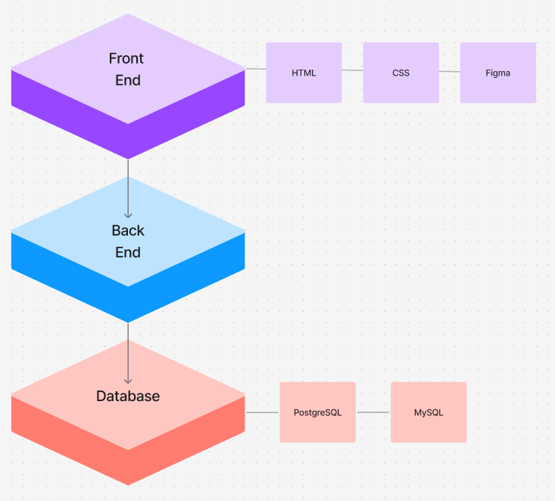
Tech Stack

Slide 7
Product overview
For Hertz we designed an integrated program where different store locations can view and request to export or import vehicles from one of the larger locations.
Upon request, they’re able to generate transfer plans between smaller locations to their assigned hub(s) and have the items readily available while still being able to maintain a large inventory in the transferred location.
Prototype Demo

Slide 8
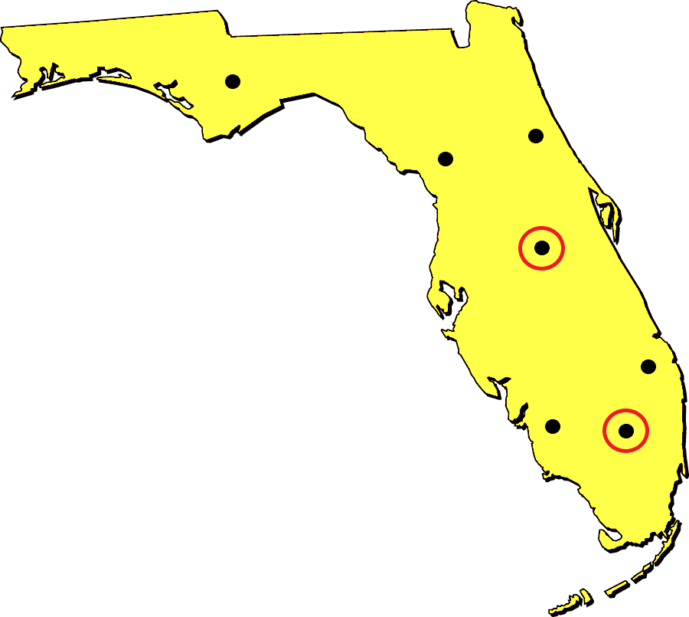
SentinelFleet Map Overview
Store Location
SentinelFleet Hubs

Slide 9
Impacts and Change
With the implementation of this project this will provide the company to exceede upon :
Consumer | Company
Assurance* Reliability (increased availability) Brand Approval Customer Retention Improved Customer Experience | Assurance* Sustainability Saving on transport (example: gas) Product security (decreasing liabilities and financial loss) Increase Competiton Domination

Slide 10
Things we’ve learned
The importance of clear and fast communication
Balancing a hackathon with work and other responsibilities is challenging
Managing time effectively with time constraints
The importance of setting realistic goals based on our available time
Knowing when to pivot and scale down features
The experience is valuable even though the project isn't finished
Learning from challenges is just as important as success

Slide 11
Future Considerations
If we had more time:
Creating the front-end interface using Next.Js, JavaScript
Implementation of an API to connect to the database and the front-end
Making sure that the the interaction between between the site and database provides the correct data that is up-to-date.
Creating a back-end using Python or JavaScript

Slide 12

Growth strategy
2025: roll out a working product to Florida hertz companies
2026: gather feedback and adjust product design so that we can increase state usage
2028: increase the number of states that use our application to minimum of 10
2030: keep gathering feedback to increase the usability and convenience of our application
2040: have all US states with hertz locations using our application.

Slide 13

Q&A?

Slide 14

Thank you

